Slide 1
Chapter 12: I/O, 8255 and Device Interfacing, Part 3
CSE 3442
Tom Rethard

Slide 2
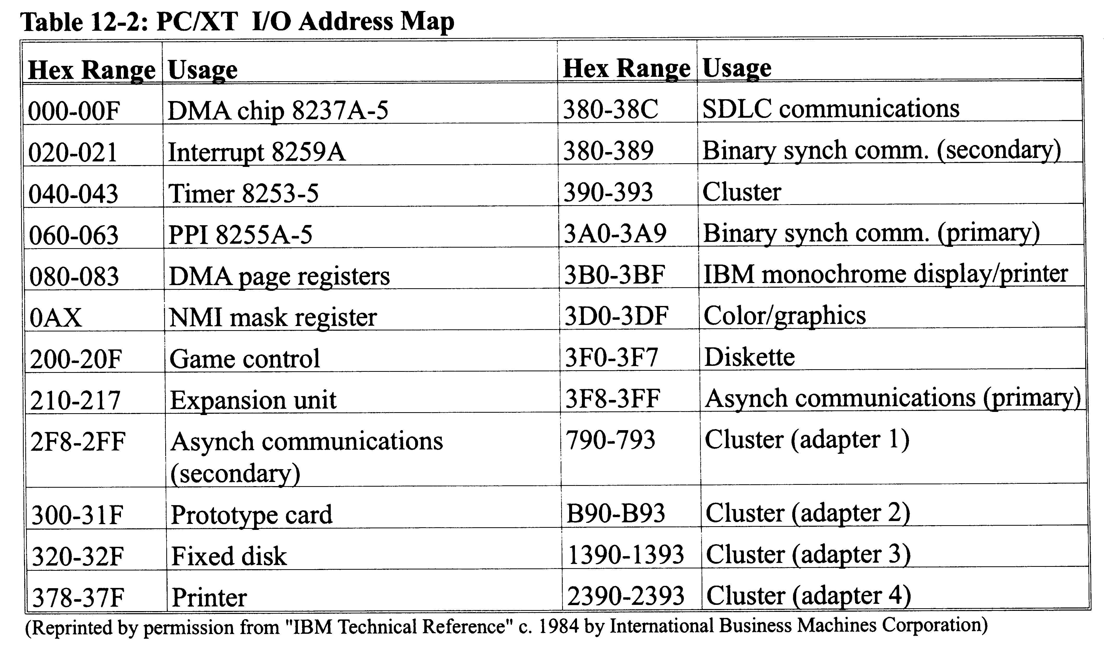
IBM PC I/O Map (Port #s)

Slide 3
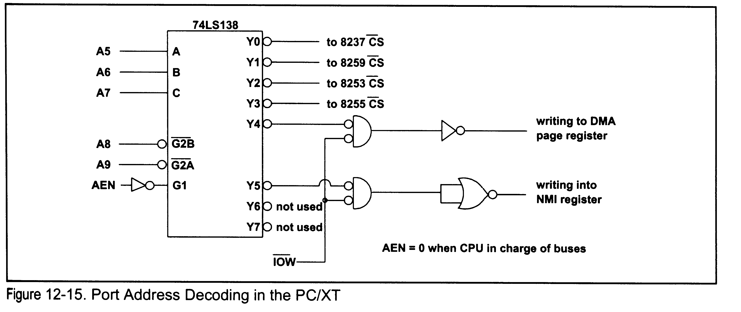
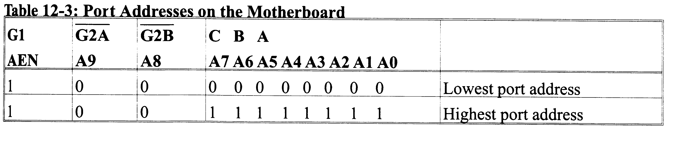
Port Address Decoding

Slide 4
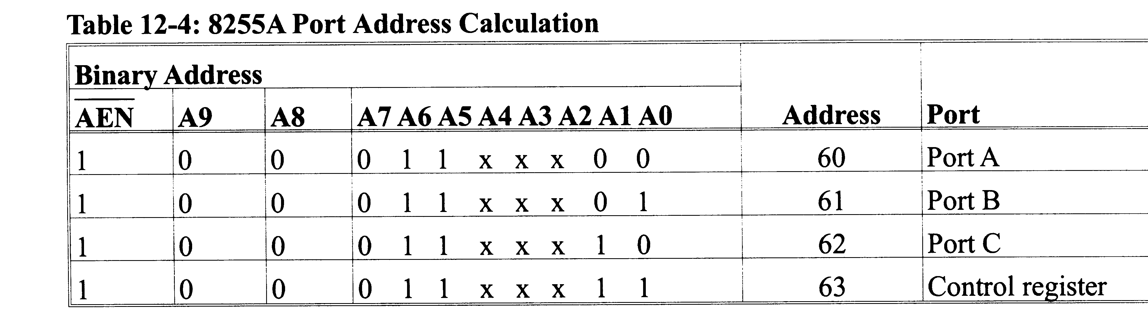
Port Addresses Using 8255

Slide 5
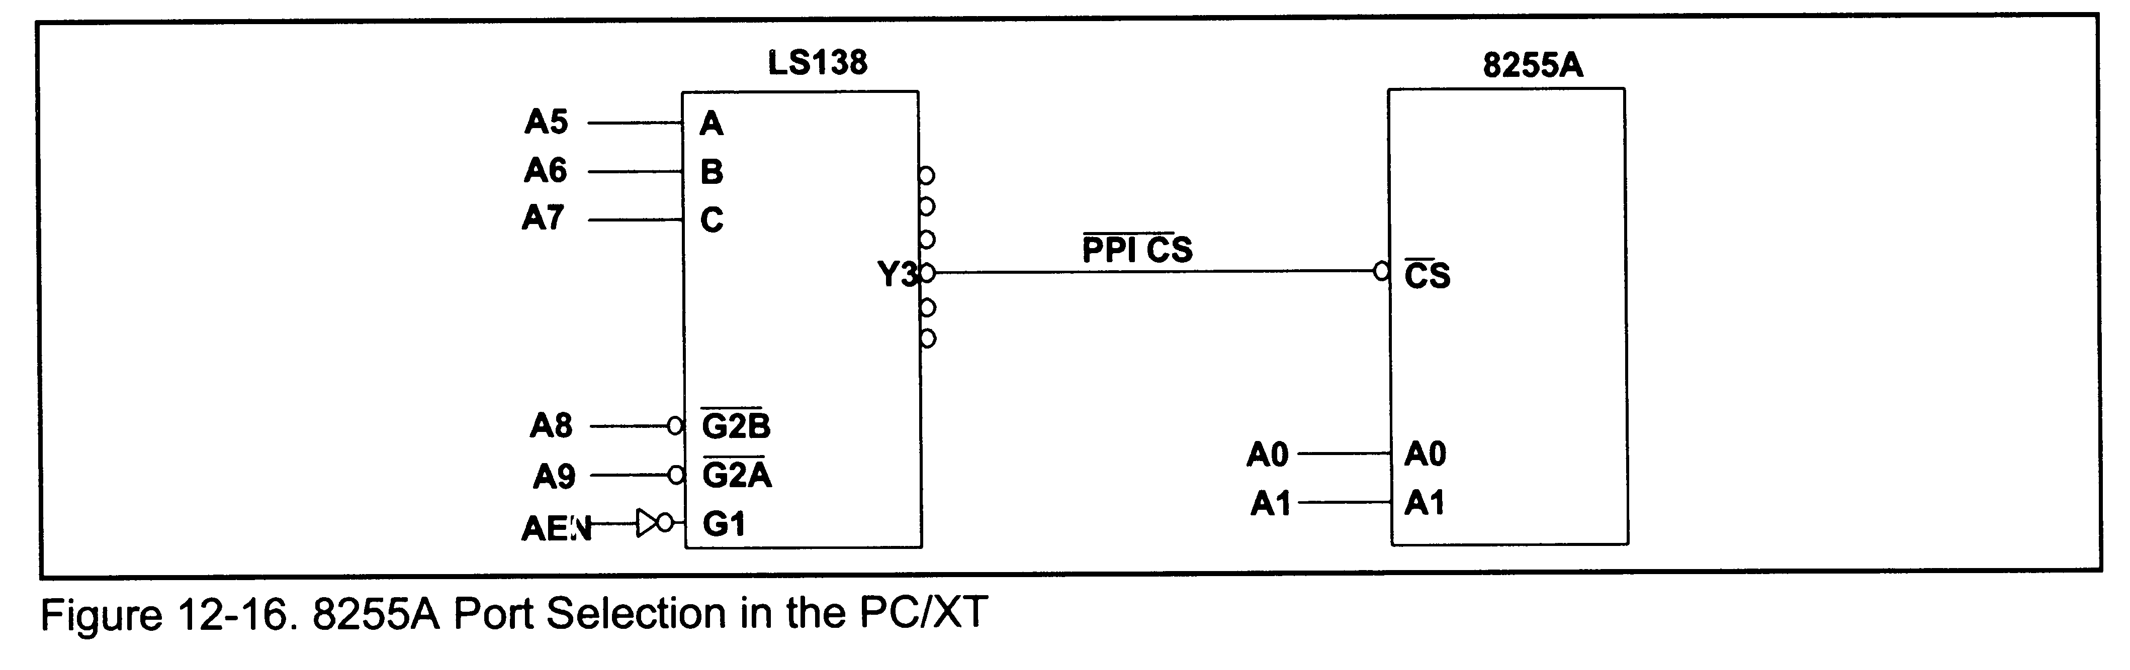
Port Selection on the XT

Slide 6
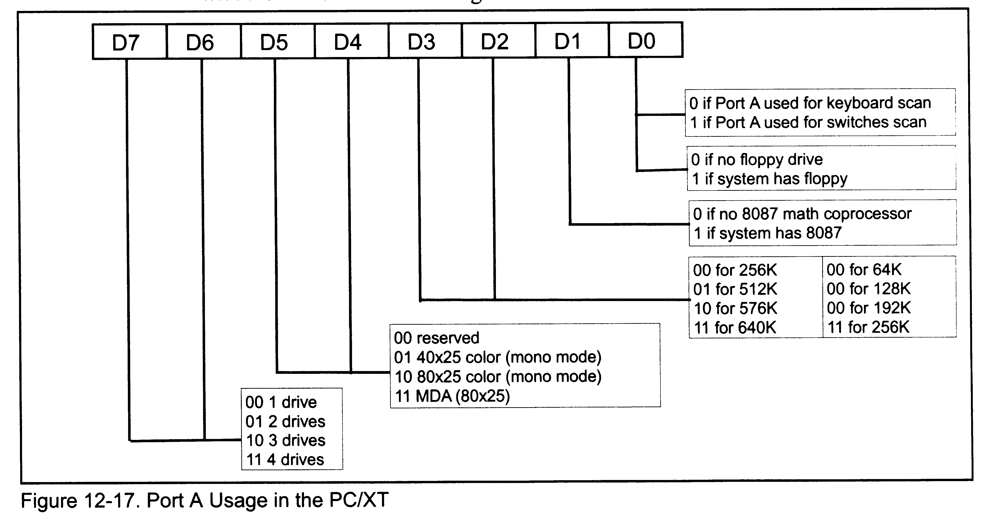
Port A on the XT

Slide 7
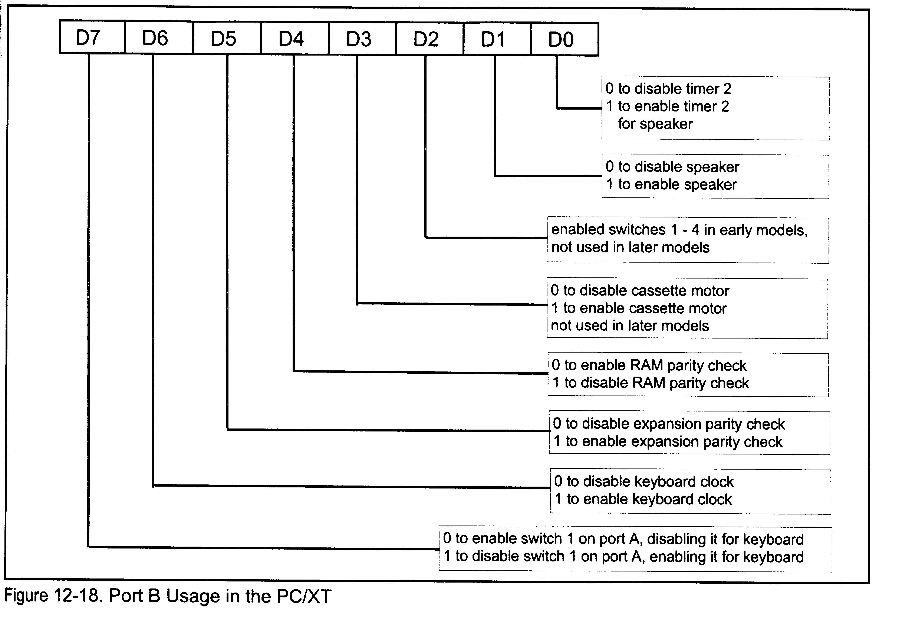
Port B on the XT

Slide 8
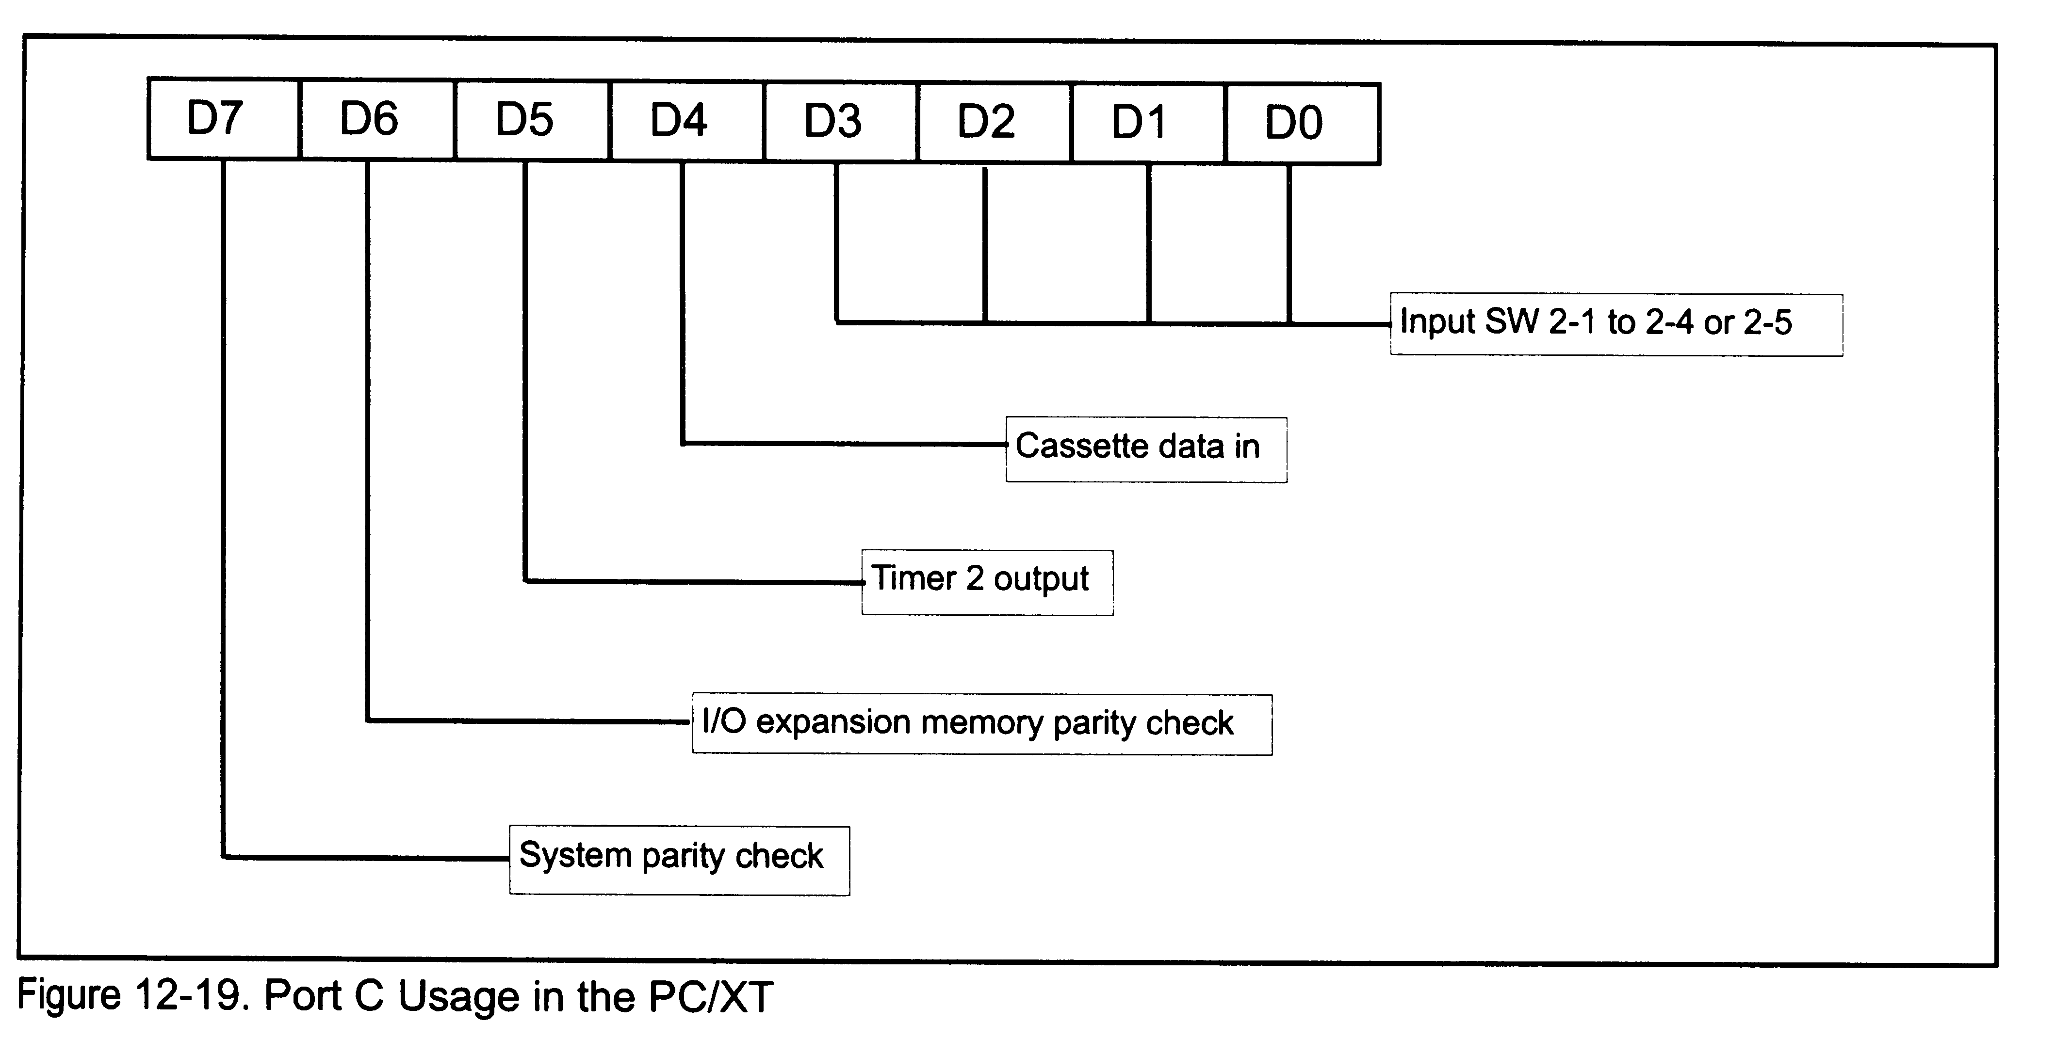
Port C on the XT

Slide 9
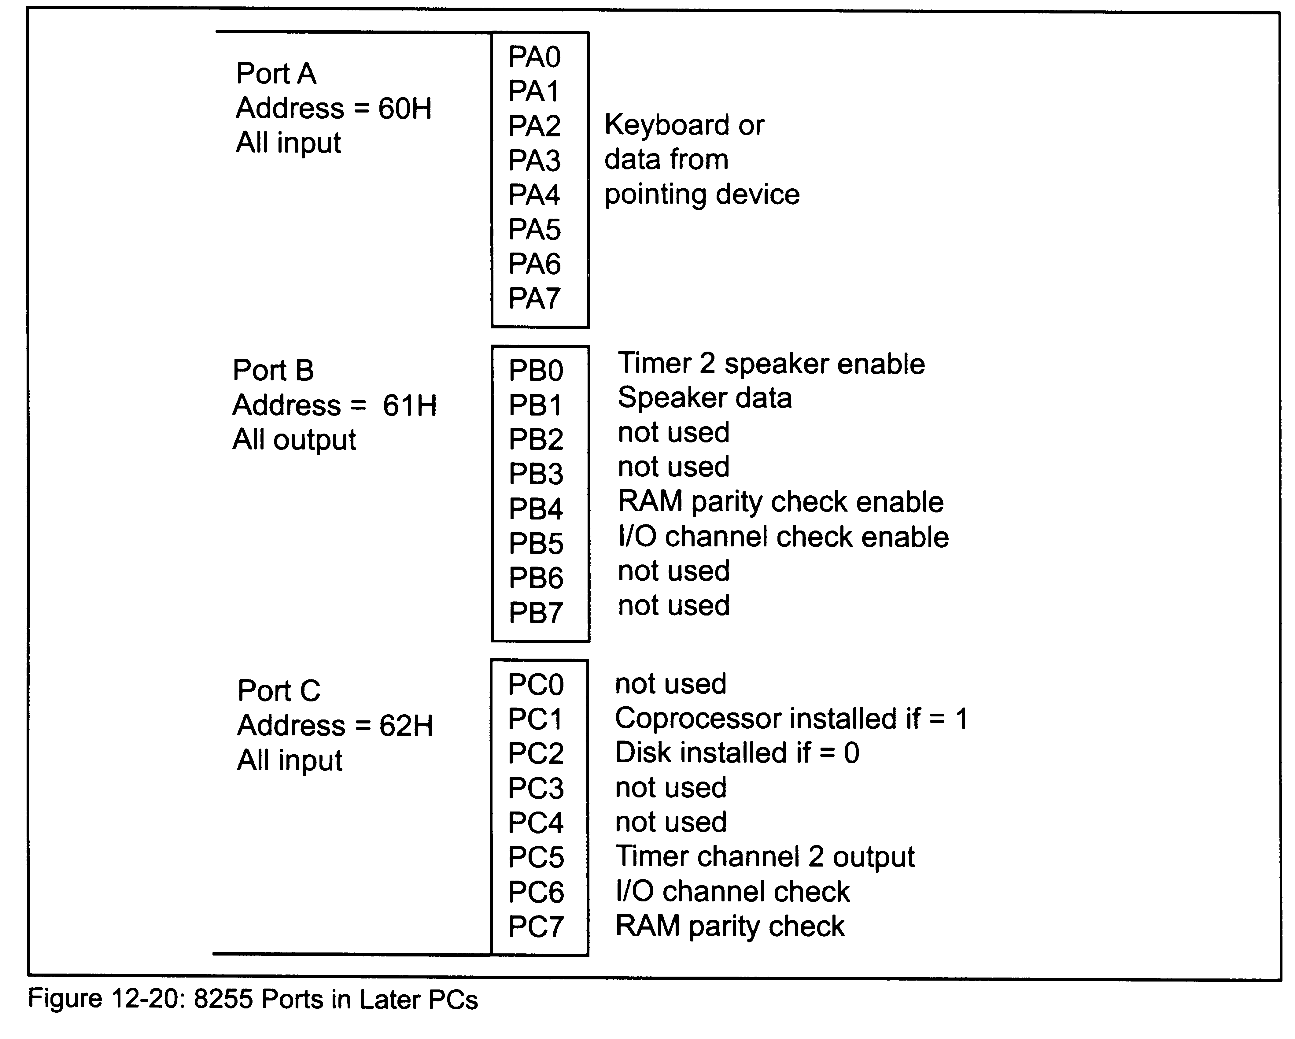
The Ports on Later PCs

Slide 10
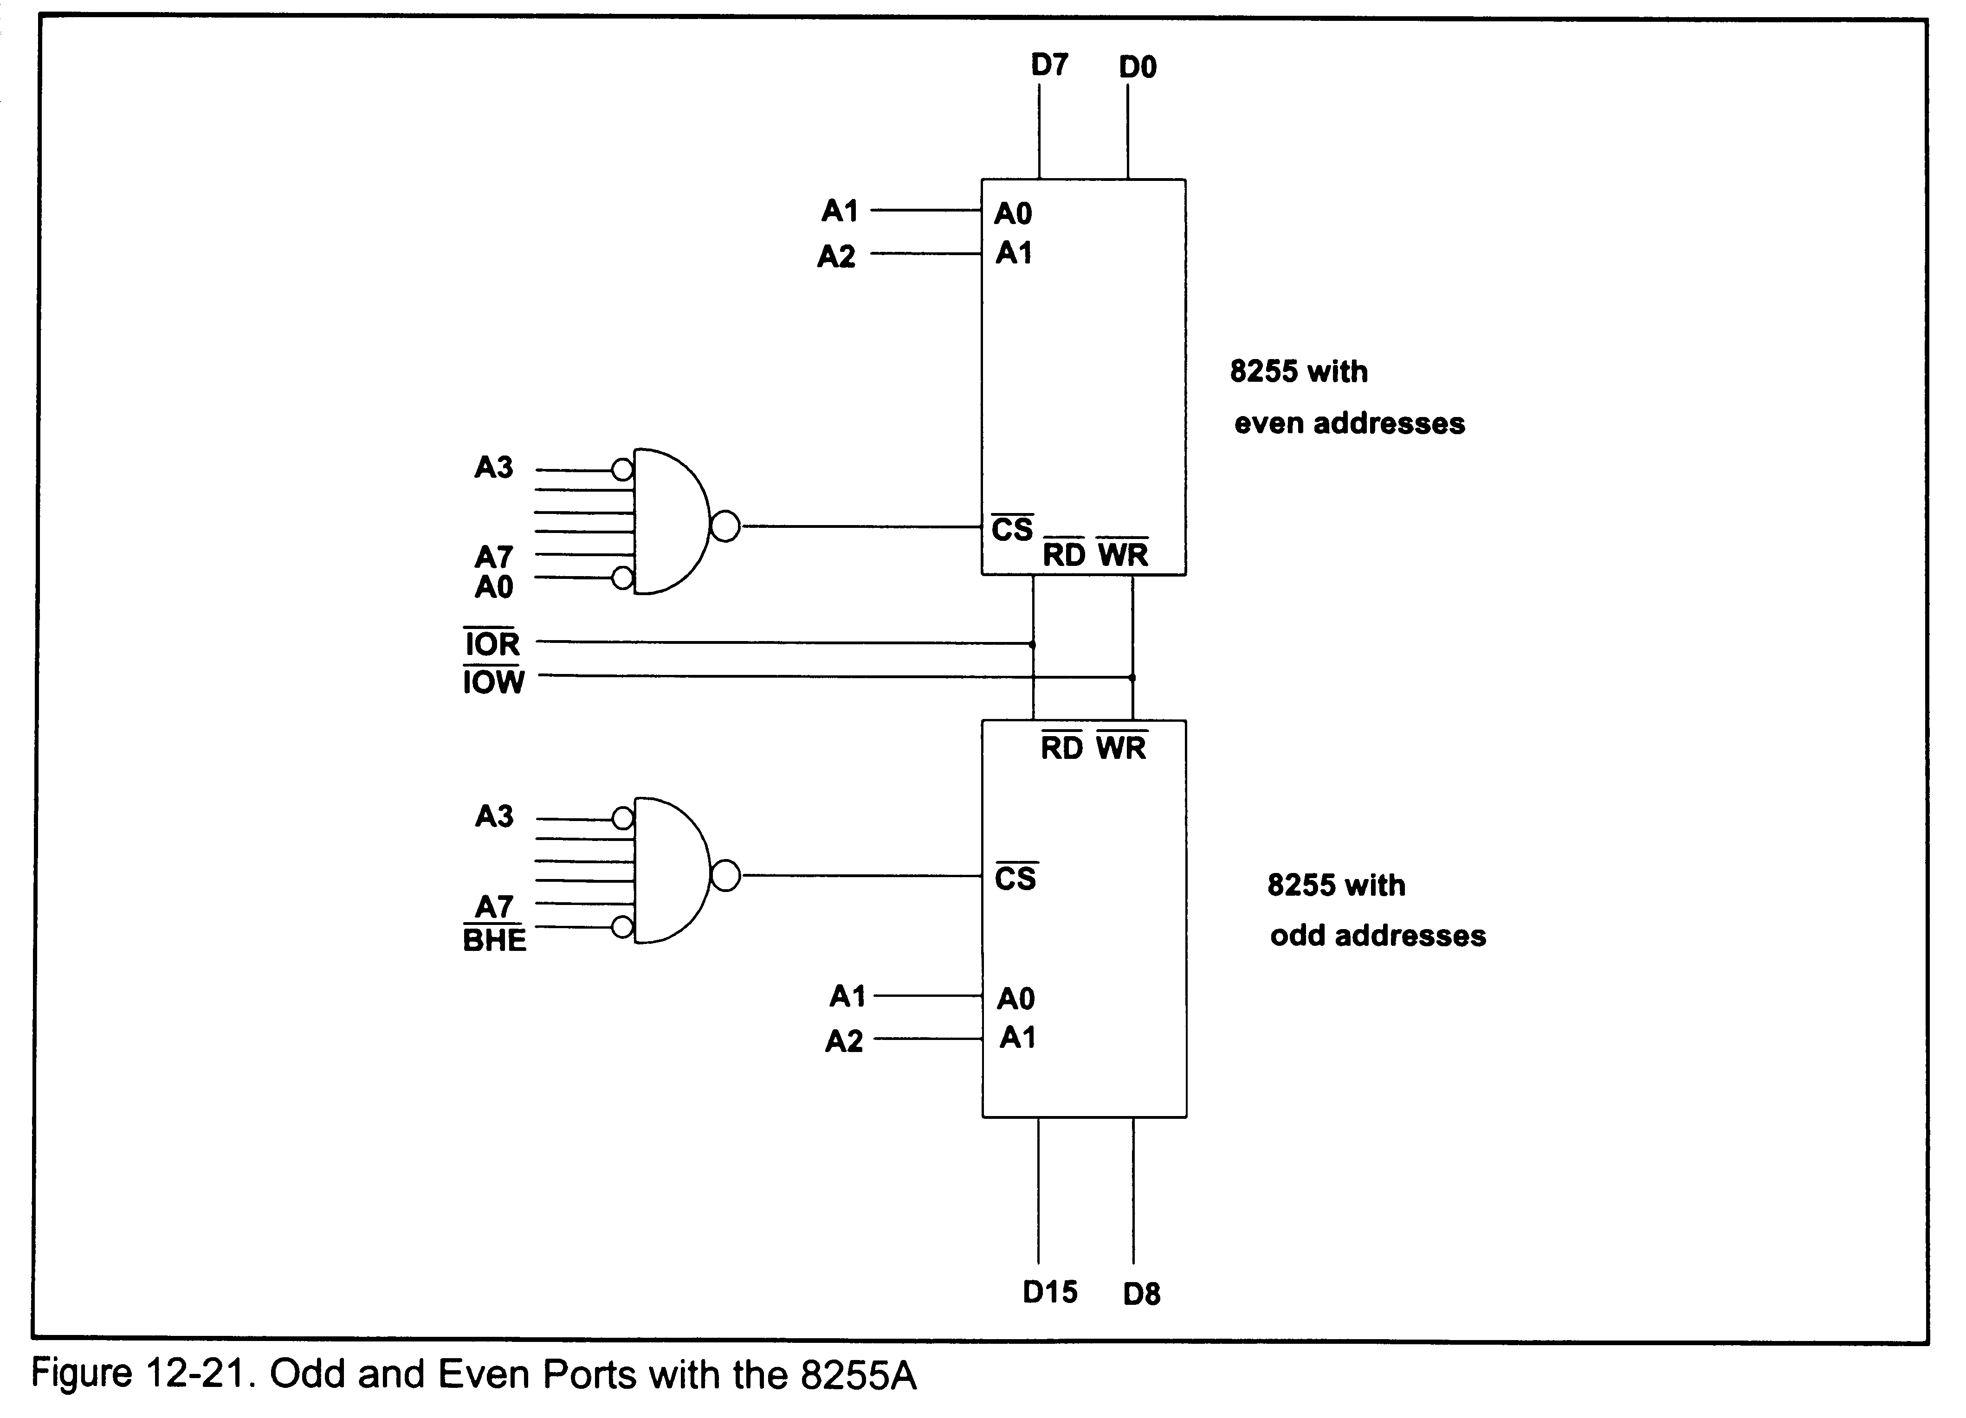
Odd and Even Ports

Slide 11
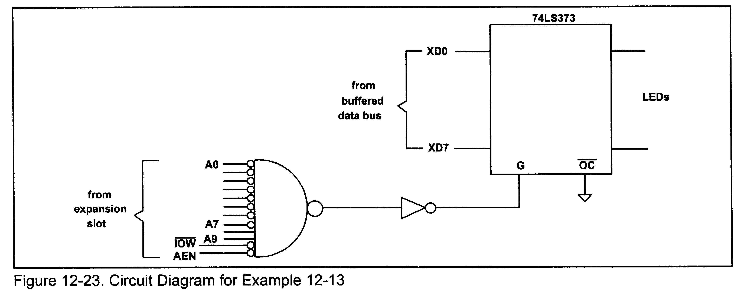
Example 12-13
Show the circuit design for the 73LS373 Latch connected to port address 300H. Use NAND gates and inverters only.

Slide 12
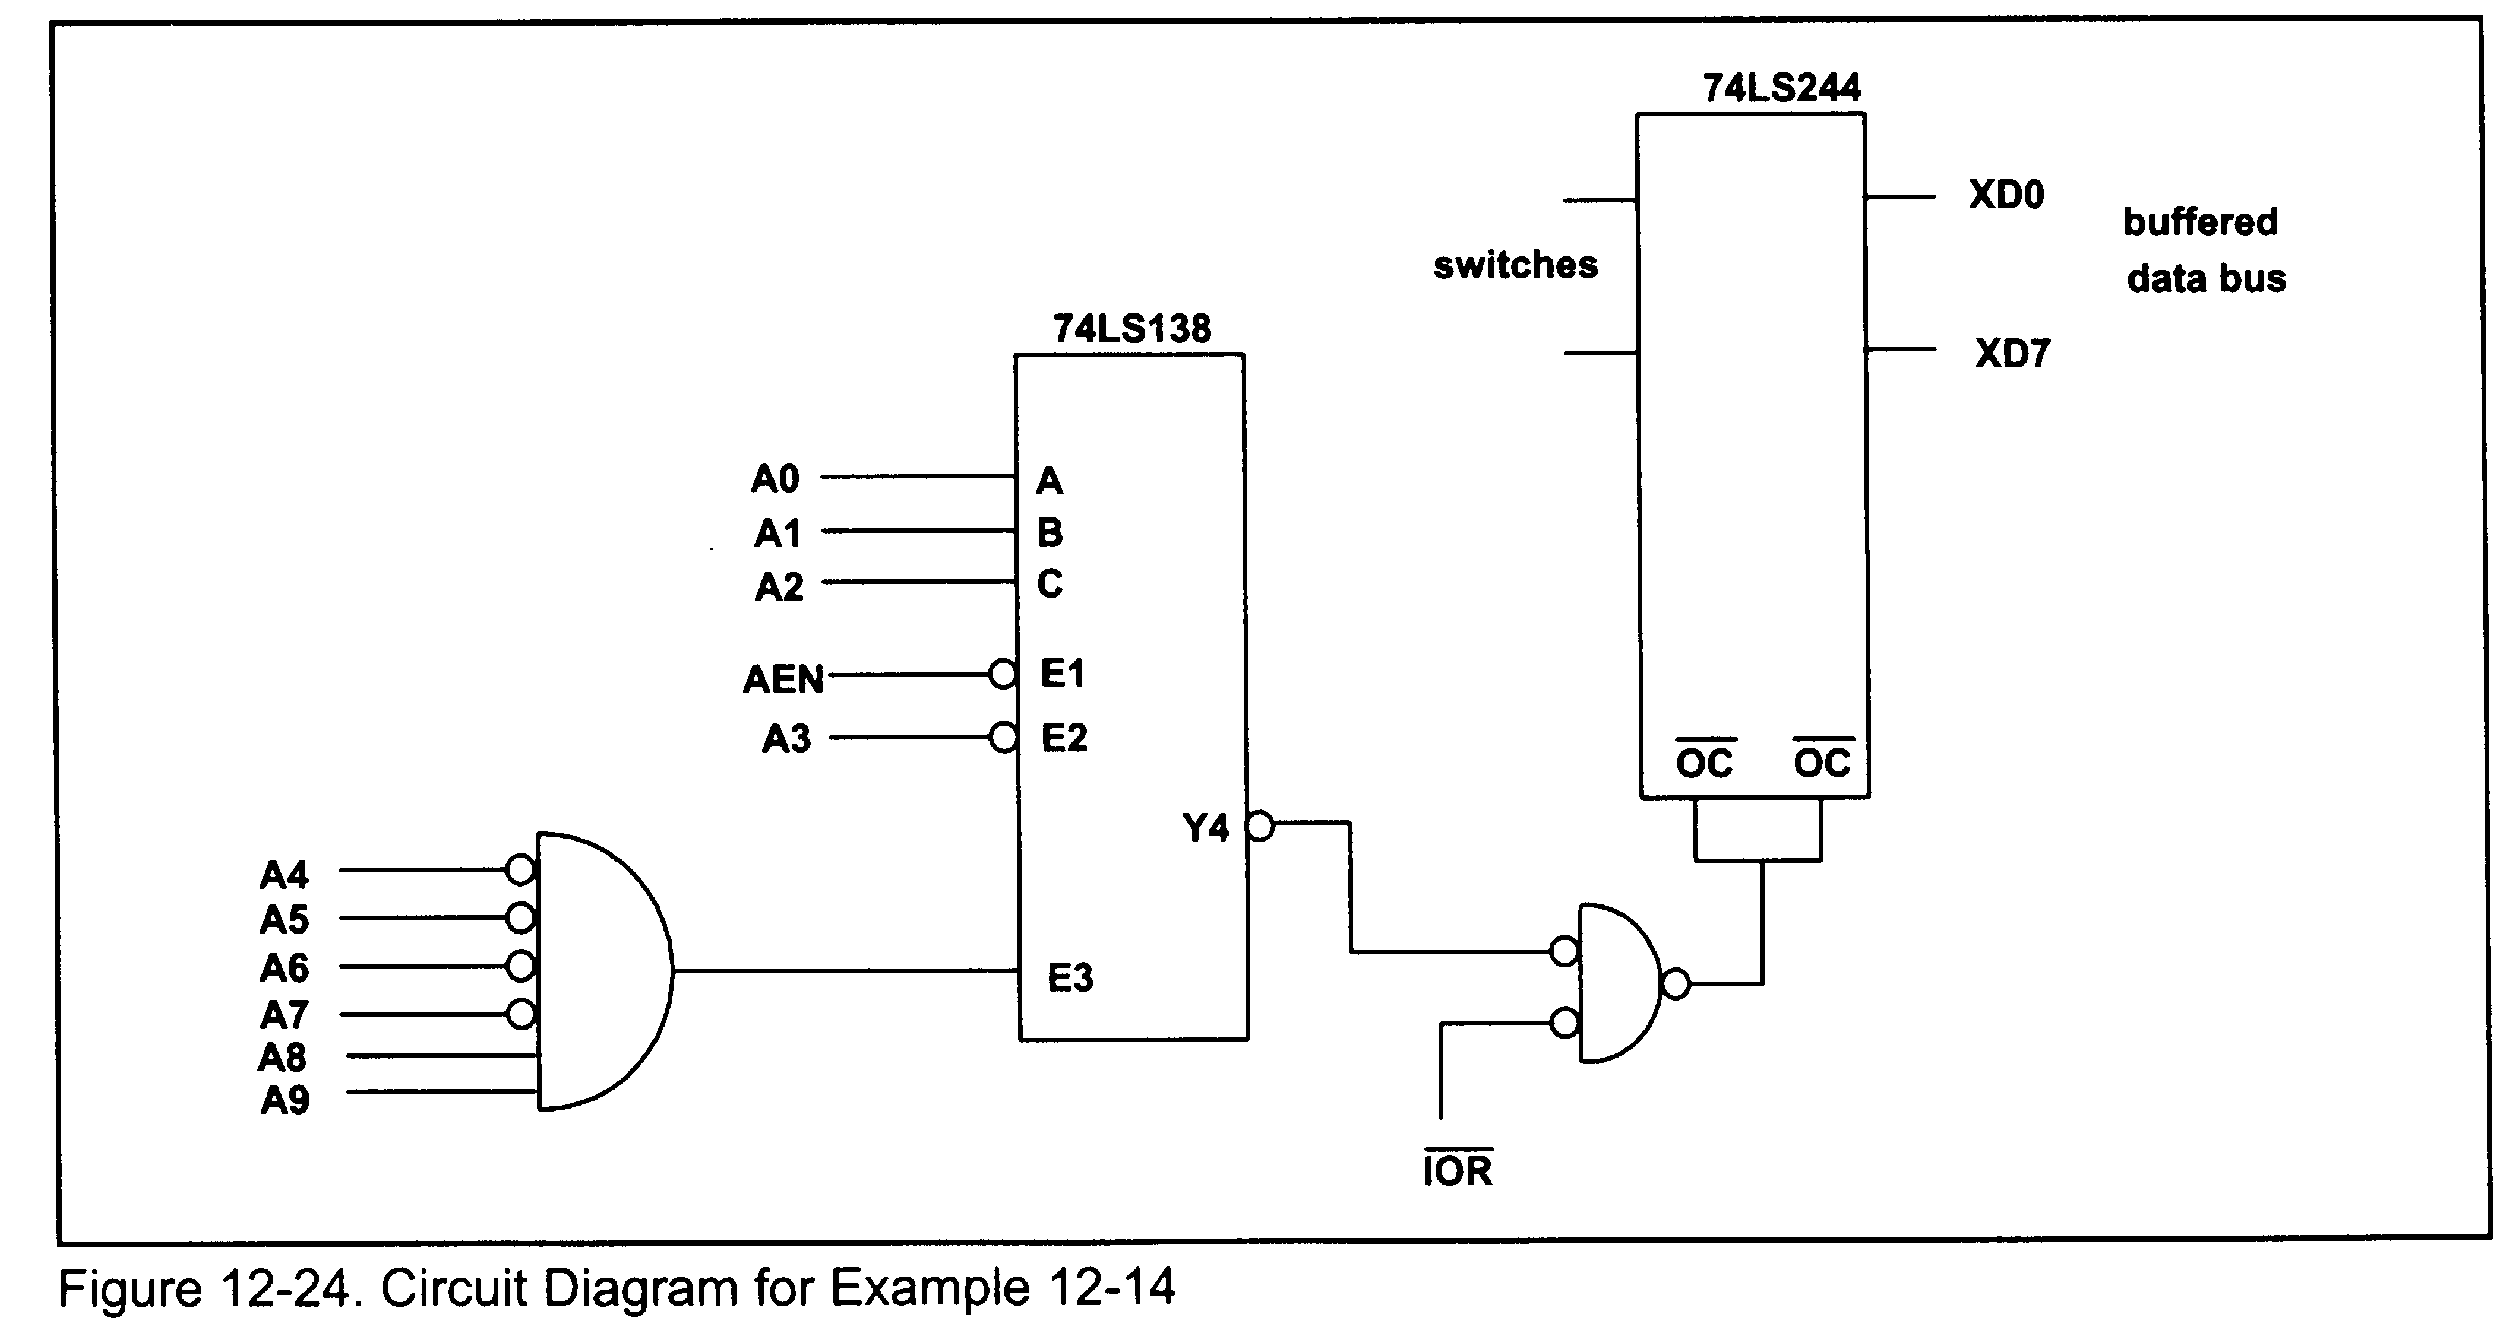
Example 12-14
Show the circuit design for an input port located at address 304H. Use 74LS244, 74LS318, and other simple logic gates, such as AND and inverters.

Slide 13
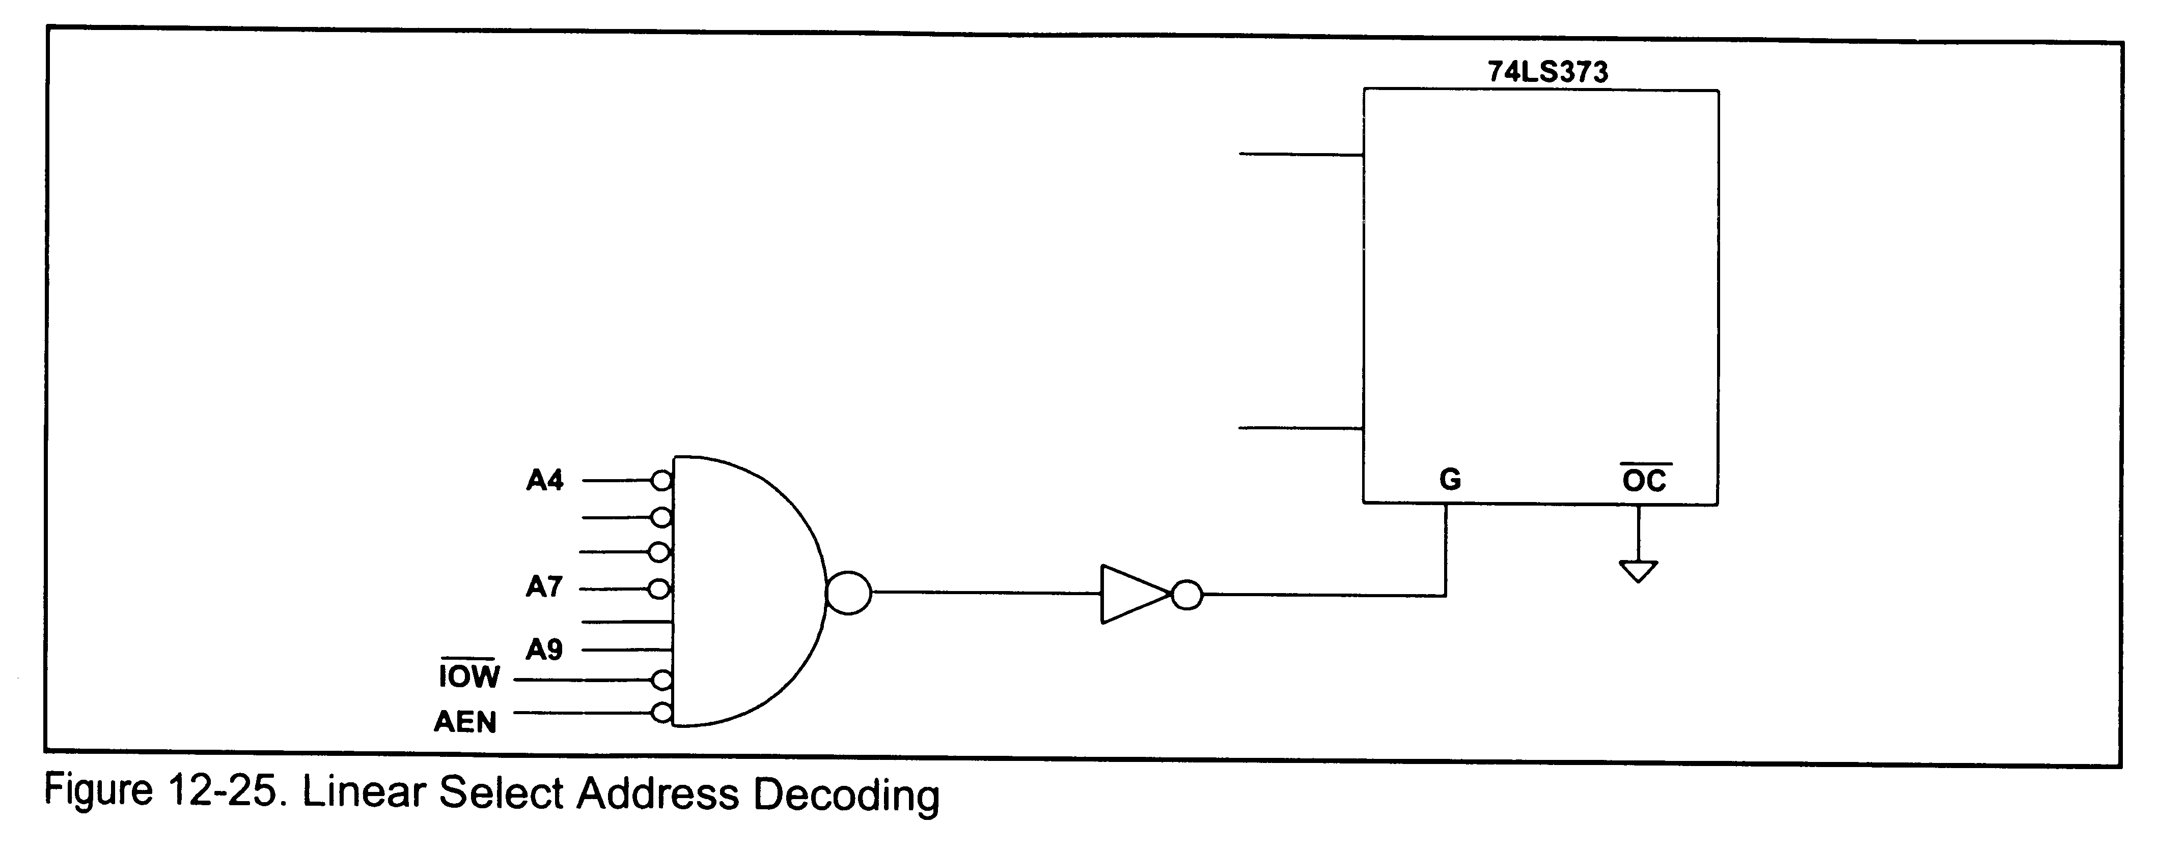
Linear Select Address Decoding

Slide 14
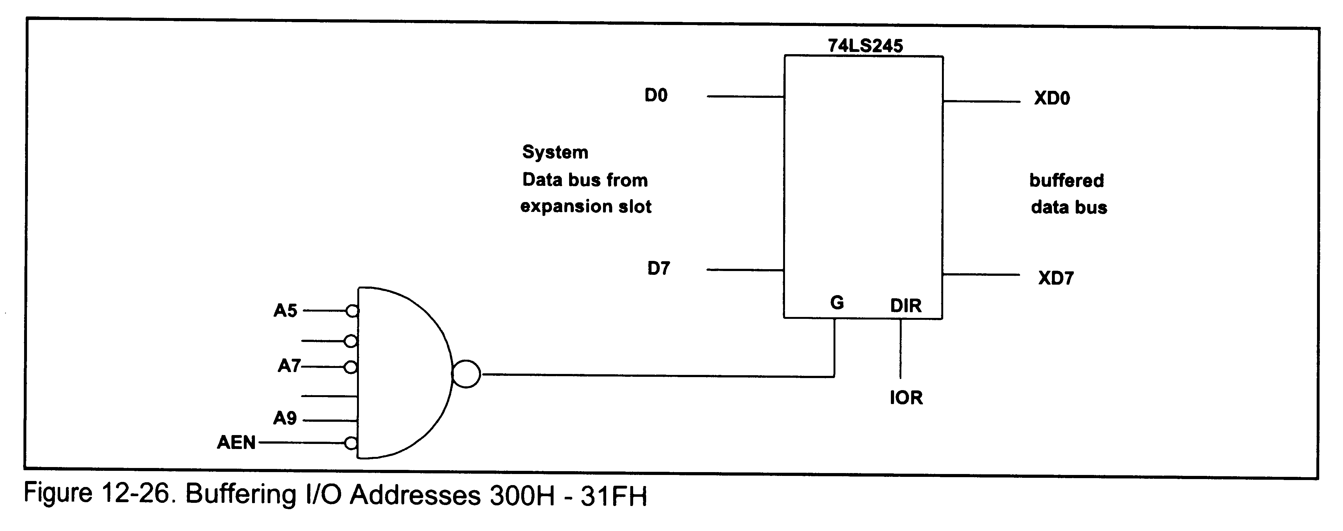
Buffering I/O Addresses 300h-31FH

Slide 15
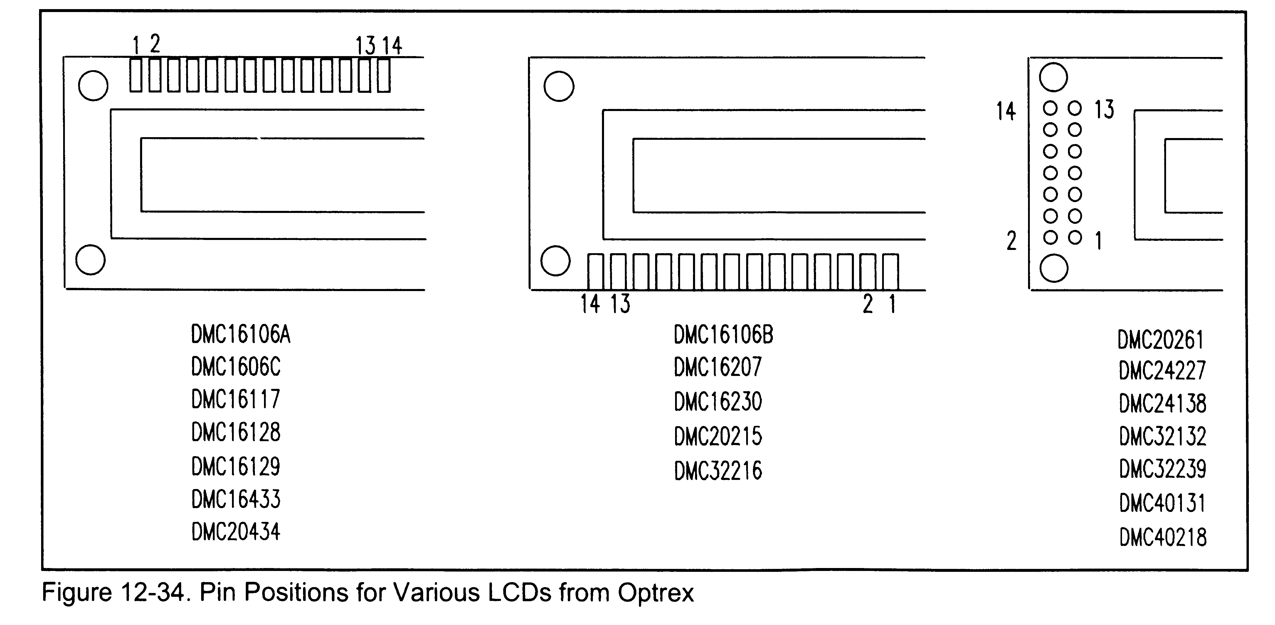
LCD Pin Positions

Slide 16
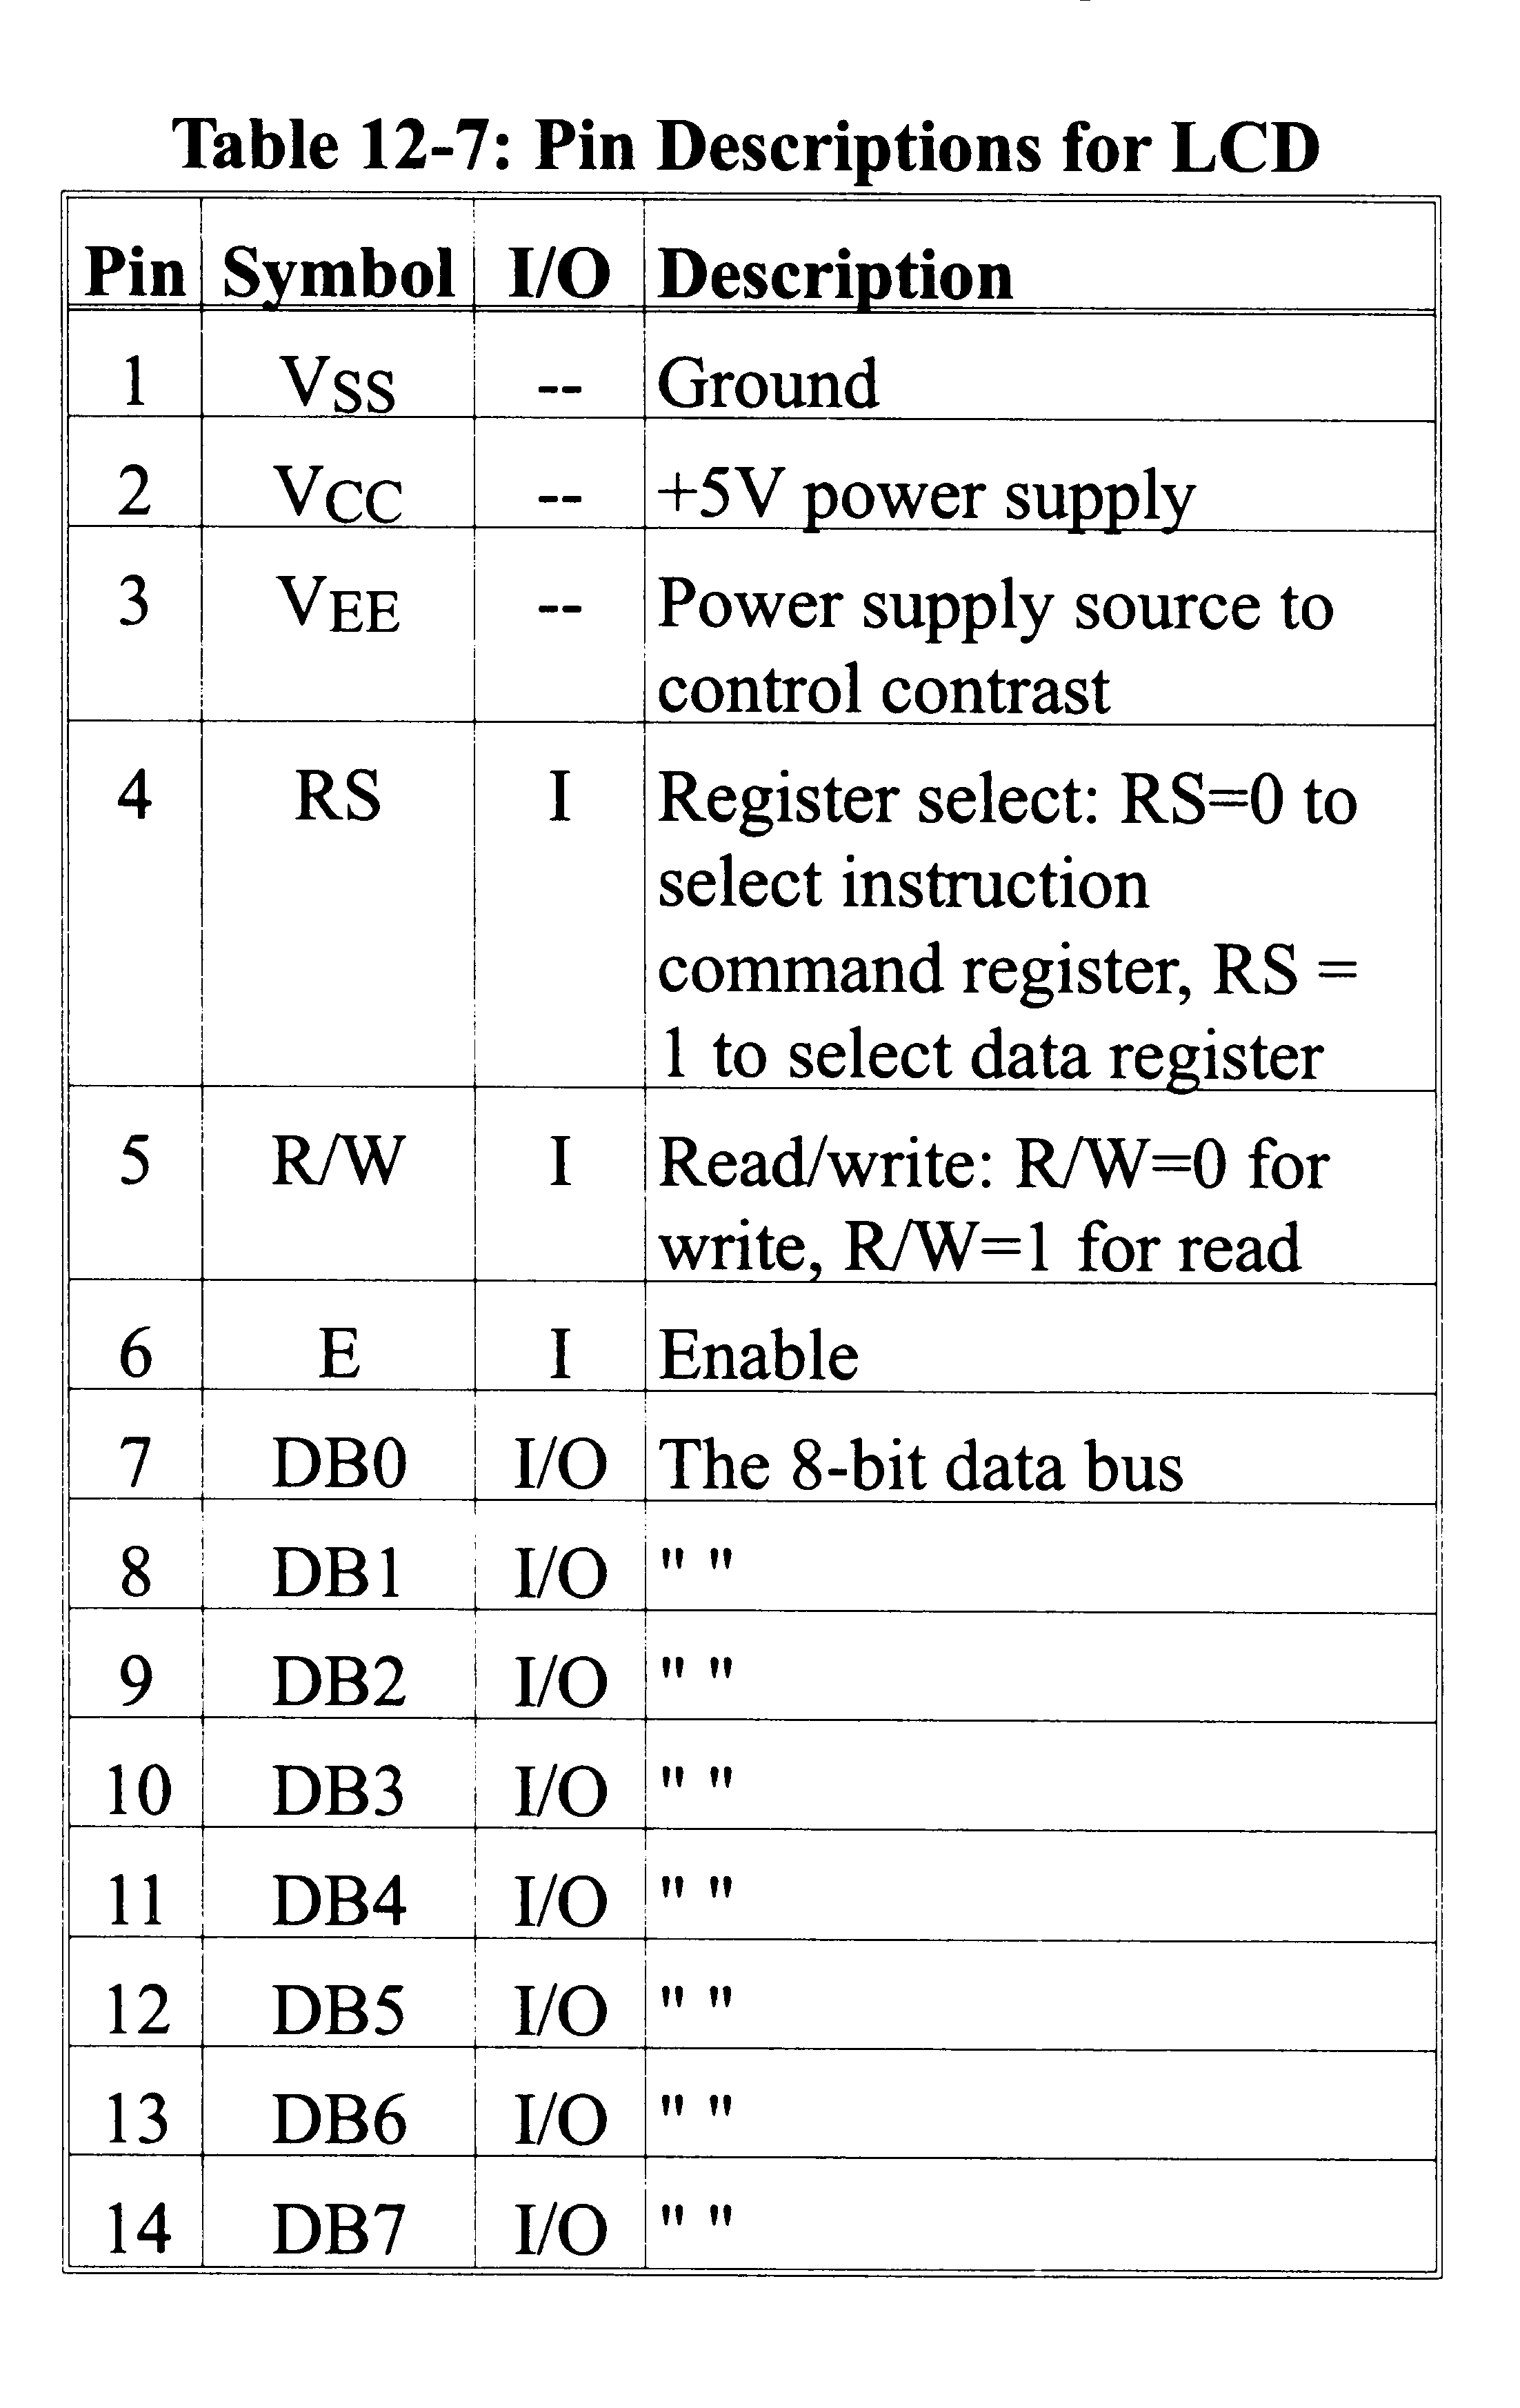
LCD Interface
Just another I/O device
Input or Output

Slide 17
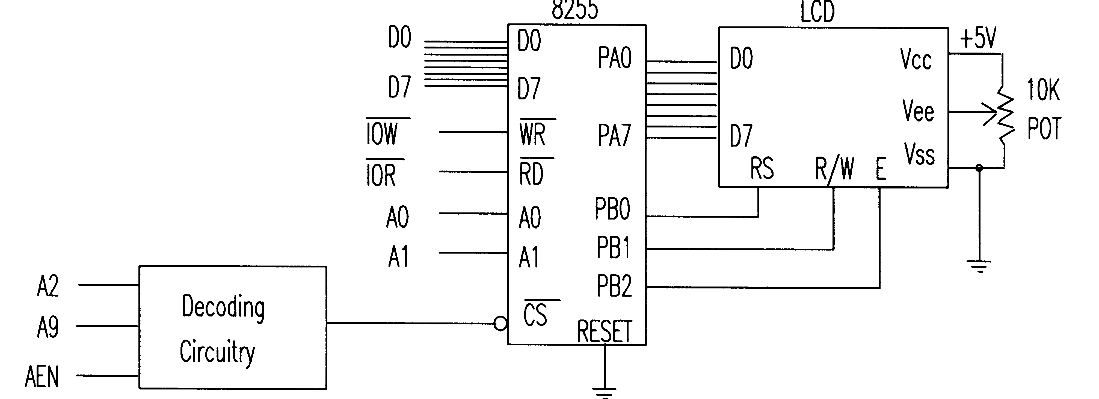
Wiring the LCD
Configure Ports A & B as output
Data pins connect to port A
LCD-RS to PB0
LCD-R/W to PB1
LCD-E to PB2

Slide 18
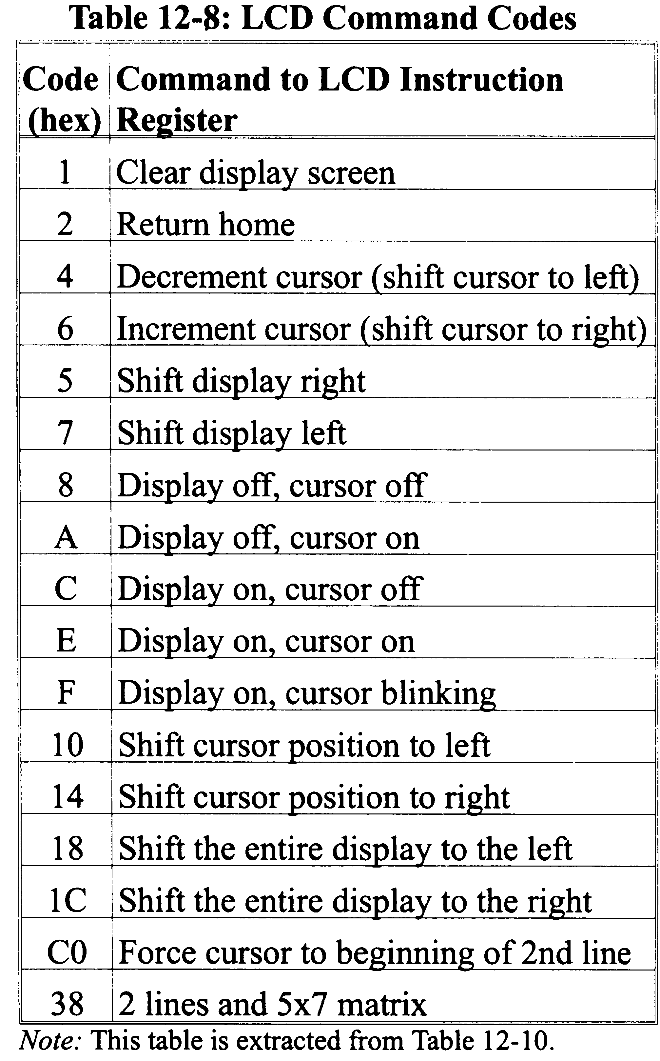
Sending Commands
Sending commands
  Make RS=0
  Check check busy flag before sending
  Send high-to-low pulse to E to cause latching of the command
  May need to insert NOPs to be sure pulse is long enough to be detected by slower chips

Slide 19
The Busy Flag
When RS=0 and R/W=1
  Can read value of D7
  D7=1 means chip is busy
  Safe to transmit data/command when D7=0 only
  Should always be checked before sending data

Slide 20
Sending Data to the LCD
Monitor the busy flag to be sure the chip is ready to receive
Set RS=1
Send high-to-low pulse to E to enable latching of the data
Data sent is ASCII value of character to be displayed

